Slide 1


Customer Lifetime Value Prediction
t
Submitted by:
Harshita Bansal(C23013)
Rupesh Sahu(C23024)
Shruti Raj(C23029)

Slide 2







Project Description And EDA
Hypothesis Testing
Contents
Multiple regression with OLS model
ML models and evaluation

Slide 3
PROBLEM STATEMENT
In an attempt to enhance customer retention, an auto insurance company operating in the USA is exploring the use of Customer Lifetime Value (CLV) as a metric to identify loyal customers and promote exclusive promotional offers to them.
Customer Lifetime Value represents a customer’s value to a company over a period of time. It’s a competitive market for insurance companies, and the insurance premium isn’t the only determining factor in a customer’s decisions.
Using CLV effectively we can improve customer acquisition and customer retention, prevent churn, help the company to plan its marketing budget, measure the performance of their ads in more detail, and much more.
The objective of the project is to accurately predict the Customer Lifetime Value(CLV) of the customers using regression and other ML models. Do hypothesis testing using T-test, Anova and Chi-square test to find significance of features and their interdependencies

Slide 4
DATA DESCRIPTION
The dataset represents the Customer lifetime value of an Auto Insurance Company in the United States, it includes 24 columns and 9134 records to analyze the lifetime value of the Customer.
The dataset was collected from UCI Machine Learning Repository
The socio-economic data of the customer with details about the insured vehicle is the data content. Data contains both categorical and numerical variables. The customer lifetime value based on historical data has also been provided which is essential in understanding the customer purchase behavior.

Slide 5
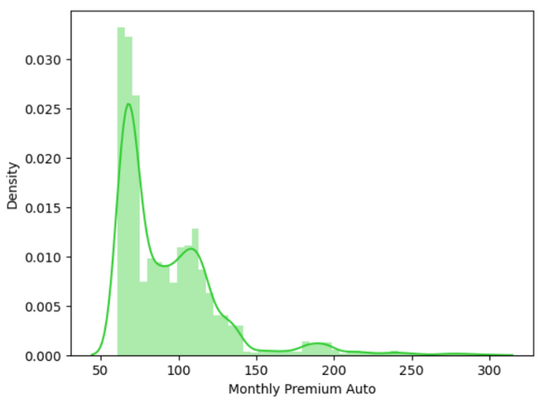
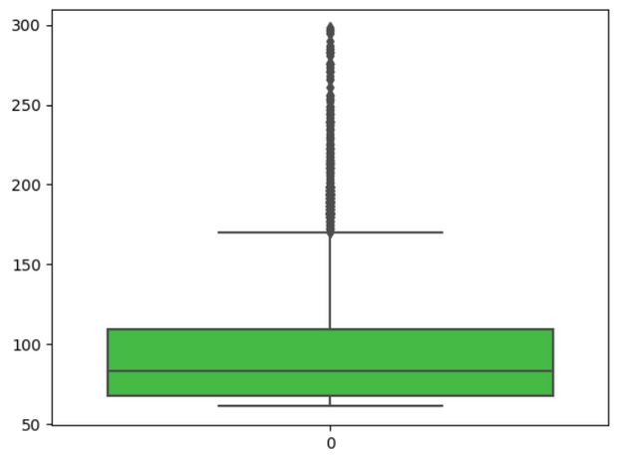
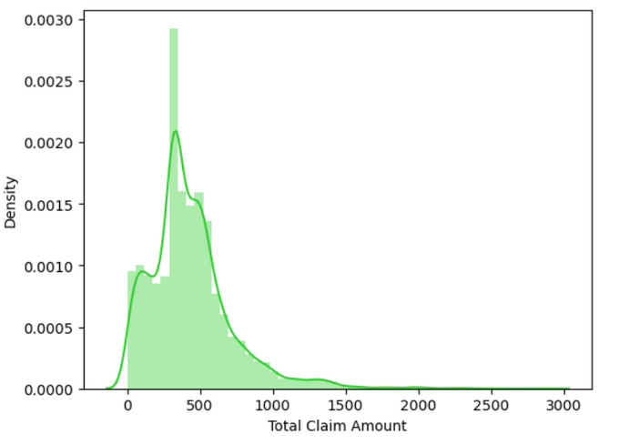
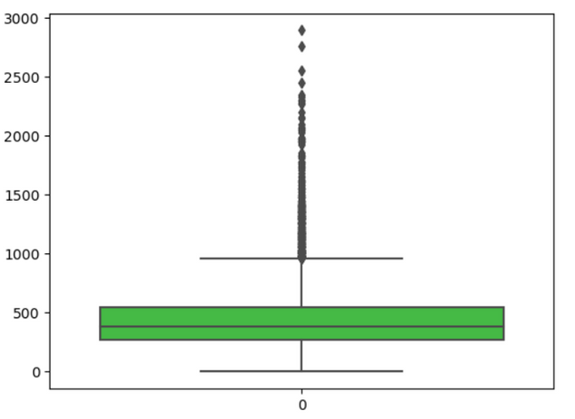
Exploratory Data Analysis
UNIVARIATE ANALYSIS

Slide 6
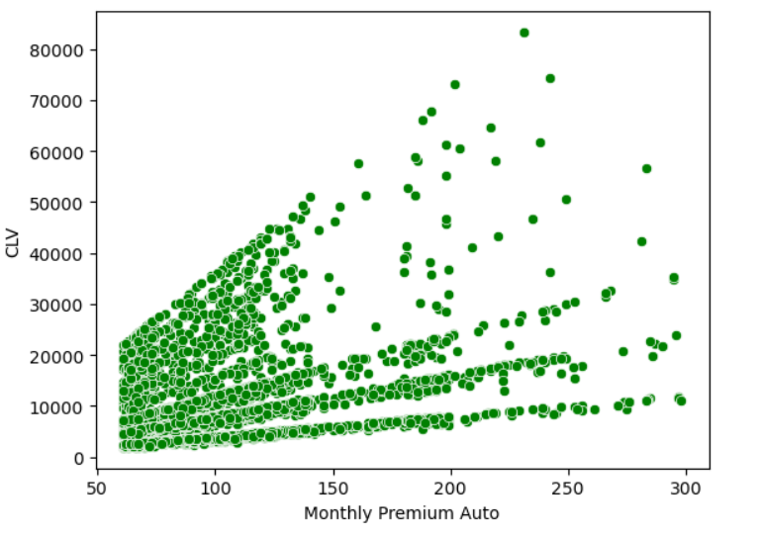
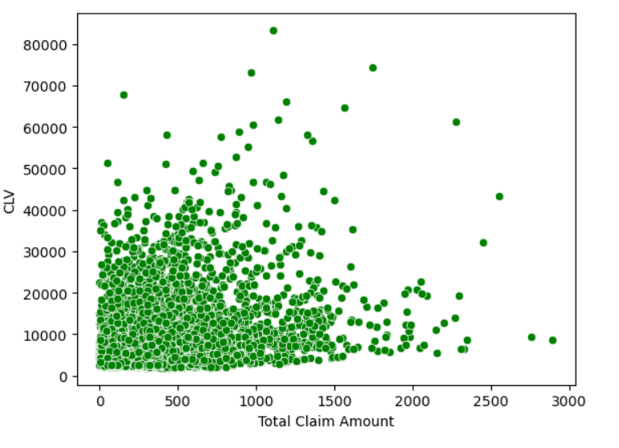
Exploratory Data Analysis
BIVARIATE ANALYSIS

Slide 7
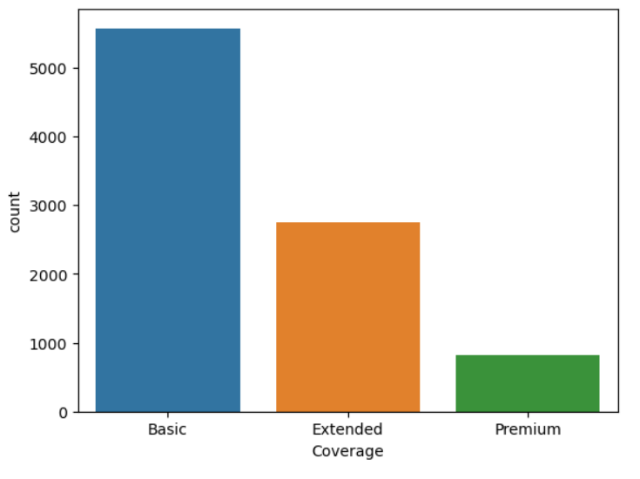
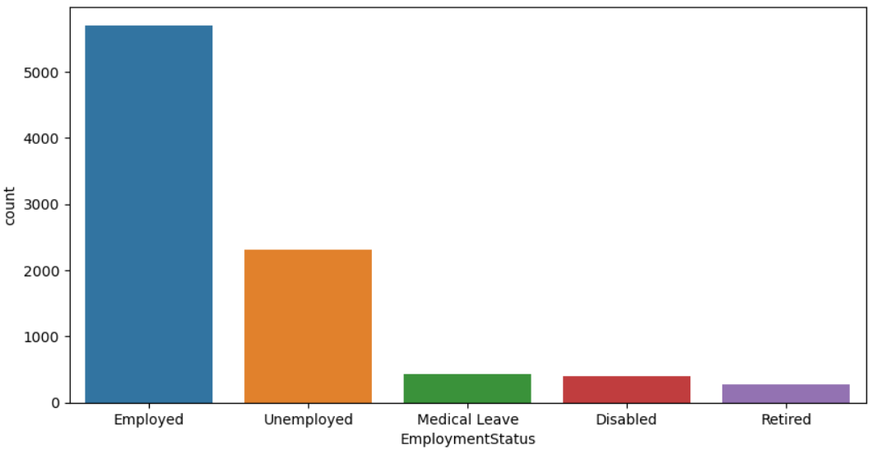
Exploratory Data Analysis
For Categorical Variables
Coverage
Employment Status

Slide 8
HYPOTHESIS TESTING
Chi-Square Test
Checking if Education depends on gender
Null Hypothesis: Gender and Education are independent of each other.
Alternate Hypothesis: Gender and Education interdependent
Result: p-value is greater than 0.05, we accept the null hypothesis, so Gender and Education are independent of each other
Similarly, we checked for :
Employment Status and State
Policy Type and Vehicle Class
Vehicle Size and Coverage
Current employment status and Education
Coverage and Policy
are independent of each other
whereas Sales Channel and Coverage , Vehicle Class and Coverage are interdependent on each other as per the p-value
10 Billion
5 Billion

Slide 9
HYPOTHESIS TESTING
T Test
Response:
H0: The null hypothesis states that there is no significant difference between the means of the two independent groups
H1: The alternative hypothesis suggests that there is a significant difference between the means of the two independent groups.
Result: The p-value exceeding 0.05 suggests that we do not have sufficient evidence to reject the null hypothesis. This indicates that there is no significant difference in the mean of customer lifetime values (CLV) between the group of customers who responded positively and the group who responded negatively. Therefore, we conclude that there is no statistically significant distinction in CLV values between the two groups.
Gender:
H0: The null hypothesis states that there is no significant difference between the means of the two independent groups
H1: The alternative hypothesis suggests that there is a significant difference between the means of the two independent groups.
Result: p-value is greater than 0.05 we failed to reject the null hypothesis i.e the mean is the same for both males and females.
After conducting independent t-test on the two features, we have determined that they are not statistically significant predictors
of the target variable
Our Management Team
Briefly elaborate on what you want to discuss.
Back to Agenda

Slide 10
HYPOTHESIS TESTING
Anova Test
H0: The null hypothesis states that there is no significant difference in the means of the CLV among the different groups.
H1:Atleast one group has significant difference in mean from others
Result: P-value is less than <0.05 for the following attributes indicating that they are statistically significant in predicting CLV, indicating it has significant difference in mean from others :
State
Coverage
Education
Employment Status
Location Code
Marital Status
Number of open complaints
Number of policies
Renew offer type
Vehicle Class
whereas for the following attributes p-value > 0.05 failed to reject H0, thus they are not statistically significant for predicting the CLV:
Policy Type
Policy
Sales Channel

Slide 11
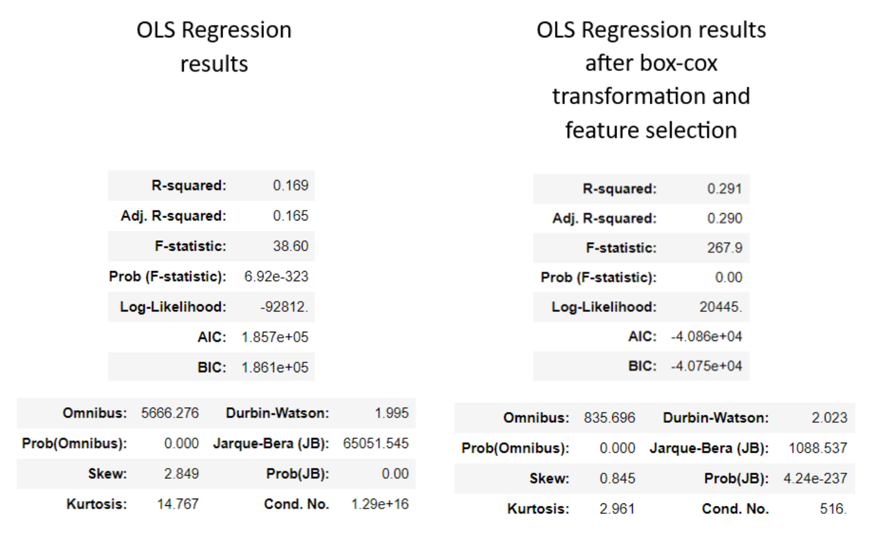
OLS MODEL

Slide 12
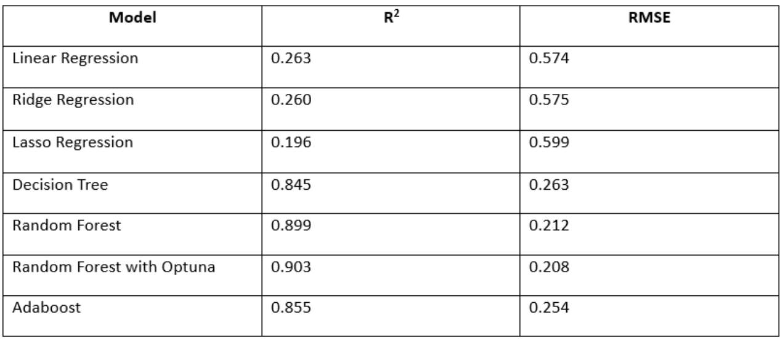
PERFORMANCE BY ALL MODELS

Slide 13
CONCLUSION
Performed EDA to understand the relation of target variable CLV with the other features.
Statistical Analysis techniques like OLS, T-test, and ANOVA test were performed to find the significance of the features with respect to the target.
Number of Policies and Monthly Premium Auto are the most important features in predicting CLV
Supervised Regression Models Linear Regression, Ridge Regression, Lasso Regression, Decision Tree Regression, Random Forest Regression, and Adaboost Regression were used
Using Optuna with Random Forest Regression gave the best RMSE and R^2 score values

Slide 14
THANK YOU
t

